Slide 1
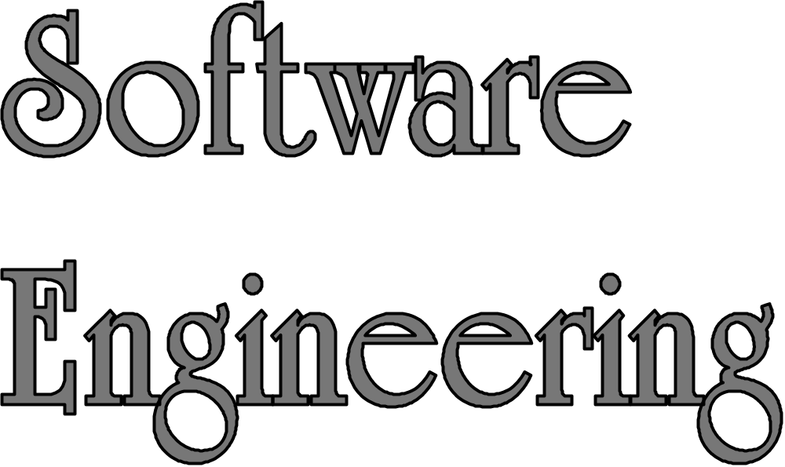
LECTURE 3: Understanding the Problem
and Dividing the Work
Instructor: Maria Striki
Presentation Slides: Ivan Marsic, Maria Striki
Rutgers University

Slide 2
Topics
Decomposition by Partitioning vs. Projection
Labor Division
Reducing Inter-team Communication
Typical Software Engineering Problems

Slide 3
Why We Want To
Subdivide Problems/Projects
Common problem-solving strategy:
“divide-and-conquer”
Labor division within the developers team
Support flexibility and future evolution by decoupling unrelated parts, so each can evolve separately (“separation of concerns”)
  Different team members can focus on different sub-problems and not worry about everything

Slide 4
How Beginners Divide the Work
List the components of the system-to-be
Each sub-group of one or more team members is assigned a different component to develop
  One or more team members is assigned to
  “write documentation”
“Chain” organization—every link is critical
If any link fails, the whole project fails
  Separation of concerns is impossible
User Interface
Business Logic
and Algorithms
Database/
Network
Documentation

Slide 5
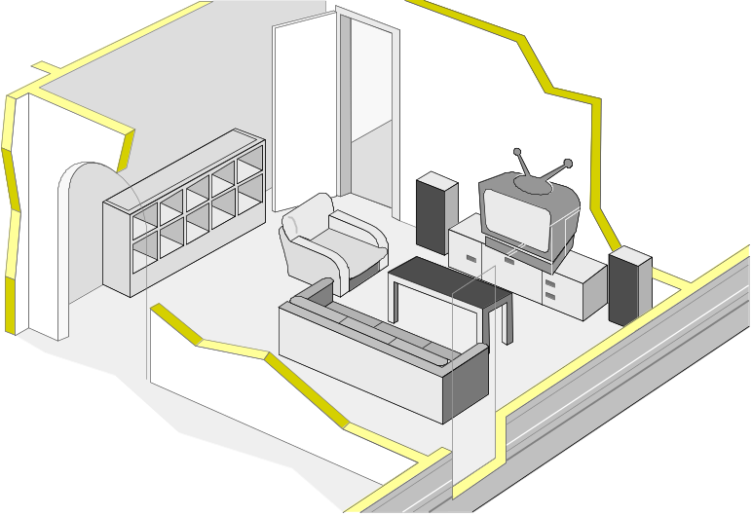
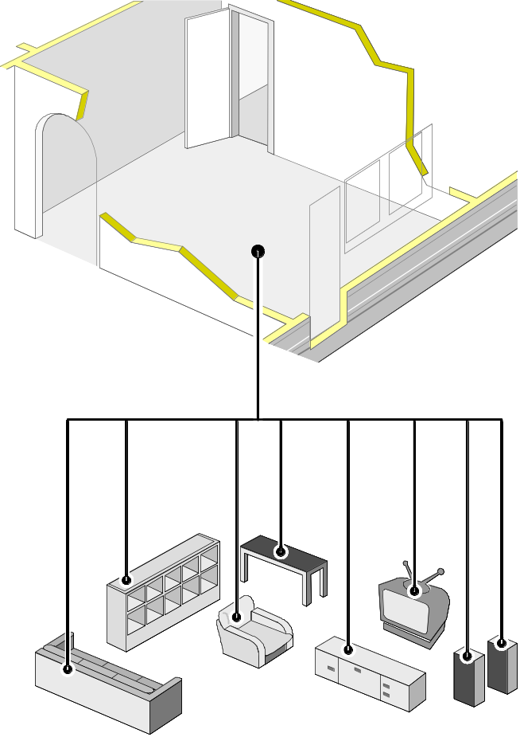
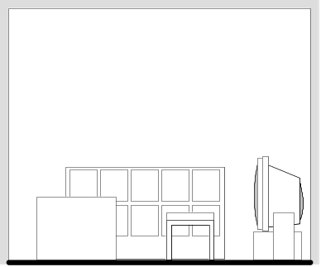


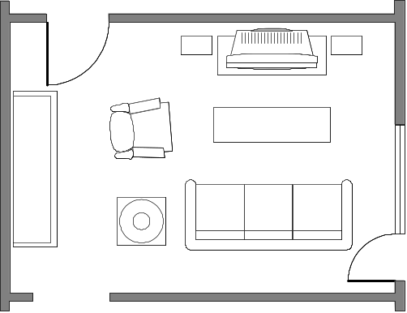
Decomposition:
Projection vs. Partitioning
Projection:
:Partitioning
Projection-based decomposition helps us understand the components in the context of their use, relative to other parts of the system.

Slide 6
Example: Restaurant Automation
Decomposition by Partitioning
Developer Team α
Developer Team Φ
Subgroup α-RED
Subgroup α-GREEN
Subgroup α-BLUE
Subgroup α-PURPLE
User Interface
Business Logic
and Algorithms
Database/
Network
Documentation

Slide 7
Example: Restaurant Automation
Communication Overhead
Developer Team α
Developer Team Φ
Function-1:
description
Function-2:
description
…
Interface for what functions?
Tables for what data?
What to write about?
User Interface
Business Logic
and Algorithms
Database/
Network
Documentation

Slide 8

Example: Restaurant Automation
Drawbacks of Team α Approach
Communication overhead:
  Most time spent in communication and “documentation writing”
  No time for creative software development
Failure-prone:
  If any sub-group doesn’t deliver, the whole project fails
Each student learns only one aspect of software development
Ownership fuzzy or one “leader”
claims all the credit
I did all coding!

Slide 9
Example: Restaurant Automation
Decomposition by Projection
Developer Team α
Developer Team Φ
Different way of “slicing” the project:
  Instead of horizontal slicing, we have vertical slicing—”stacks”
Each “stack” can be done independently of other stacks,
as a mini-project
➔ Separation of concerns!
Subgroup
Φ-RED
Subgroup
Φ-GREEN
Subgroup
Φ-BLUE
Customer-related functions
Kitchen-related functions
Management-related functions
Shared Infrastructure

Slide 10
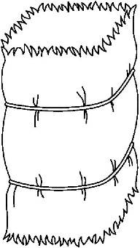
Example: Restaurant Automation
Decomposition by Projection
Developer Team α
Developer Team Φ
Team communication is simple:
They only need to define shared interfaces (“APIs”) and can focus on creative software development
What is inside of each “stack” is not discussed with other sub-teams
—for others, the contents of your “stack” is hidden—they see a black box with defined interface / APIs
Subgroup
Φ-RED
Subgroup
Φ-GREEN
Subgroup
Φ-BLUE
What do we have in common?
Customer-related functions
Kitchen-related functions
Management-related functions
Shared Infrastructure

Slide 11
Example: Restaurant Automation
Benefits of Team Φ Approach
Increased productivity:
Minimizes the amount of communication needed to coordinate the work
  → more time to focus on creative software development
Failure resilience:
Reduces the dependency on other team members—if they fail to deliver, you can still succeed and demonstrate your mini-project
(Unlike chain-organization, where a link failure leads to project failure, every stack can succeed independently of others)
Each student learns all aspects of software development
Ownership visibility:
Each mini-project can be demonstrated alone
(If expert-based, who demonstrates UI, or dBase, or …?)
Customer friendly:
The customer/user knows who to ask about each functional feature

Slide 12
What is “Shared Infrastructure”?
Needs to be discovered, as we will learn in subsequent lectures
May be a relational database, so whole team needs to discuss together the design of the shared tables
May be data items communicated via messages
May be “services” accessed by method calls

Slide 13
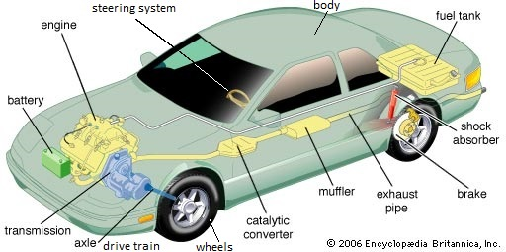
Counterexample?
Car subsystems -- different companies produce different subsystems!
Why cannot we do the same?!
… but, you are not at this level of understanding of your problem!

Slide 14
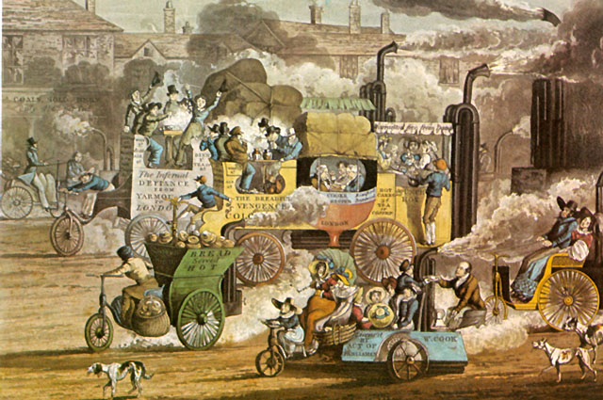
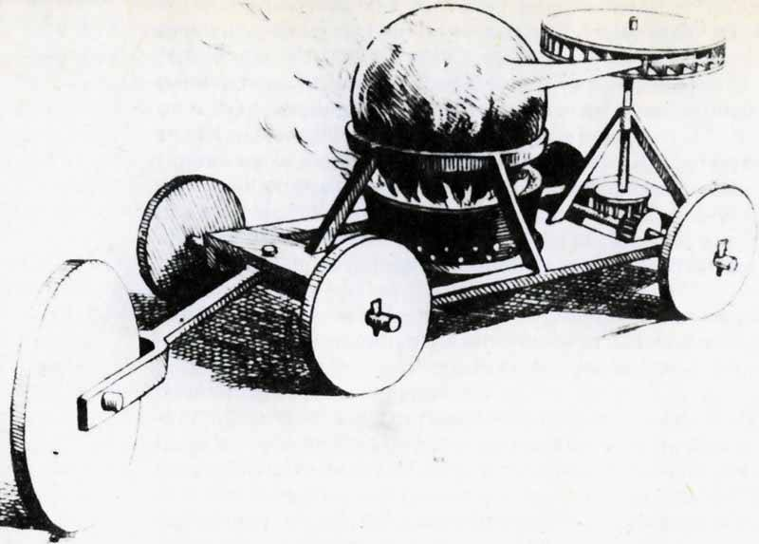
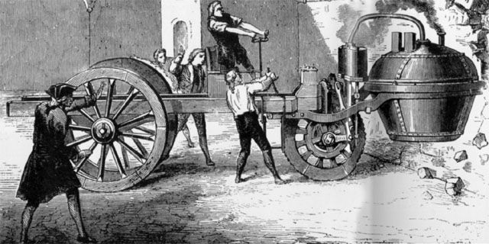
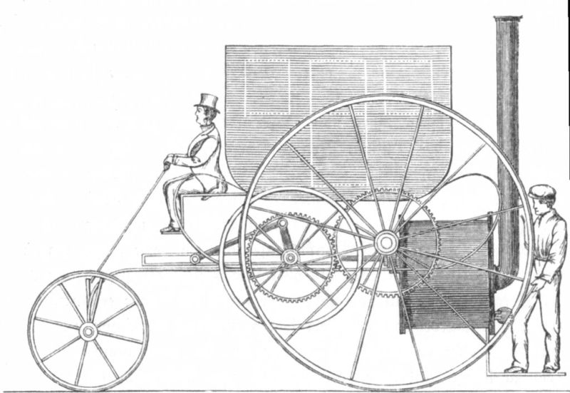
Counterexample Rebuttal (1)
Actually, you are at this level of understanding of your problem:

Slide 15
Counterexample Rebuttal (2)
Before we could do this
there was a lot of trial-and-error
and each subsystem evolved independently
to solve a different sub-problem

Slide 16
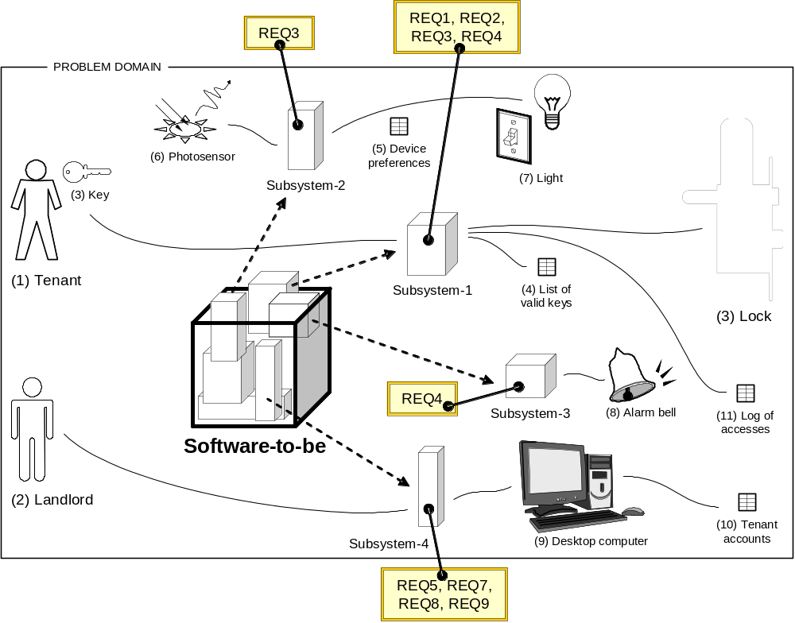
Problem Decomposition
System requirements provide the “projection axes” for problem decomposition
—different subsets of requirements identify different sub-systems.

Slide 17
Typical System Requirements
REQ-1: Map input data to output data as said by given rules
REQ-2: Allow repository (or document) editing, where “repository” is a collection of data
REQ-3: Automatically control a physical object/device
REQ-4: Interactively control a physical object/device
REQ-5: Monitor and display information about an object
➔ Only a “5-dimensional” problem space!
(Problem complexity can vary independently along each dimension)
Note:
These “typical requirements” will be discussed further under “Problem Frames”

Slide 18
Typical Software Eng. Problems
1. User works with computer system
(problem domain is “virtual”, not physical)
1.a) System transforms input document to output document
REQ-1: Map input data to output data as said by given rules
IN doc
System
OUT doc
1.b) User edits information stored in a repository
User
System
System
REQ-2: Allow repository editing, where “repository” is a collection of data
Repository
User
2. Computer system controls the (physical) problem domain
(user not involved)
REQ-3: Automatically control a physical object/device
System
Problem domain
3. Computer system intermediates between
the user and the problem domain
3.a) System observes the problem domain and displays information
REQ-5: Monitor and display information about an object
User
System
Problem domain
User
System
Problem domain
3.b) System controls the problem domain as commanded by the user
REQ-4: Interactively control a physical object/device
User
System
Problem domain

Slide 19
Example: Problem Decomposition
[ Case Study 1: Safe Home Access ]
Required Behavior
REQ1: keep door locked and auto-lock
REQ2: lock when “LOCK” pressed
REQ3: unlock when valid key provided
REQ4: allow mistakes but prevent dictionary attacks
REQ5: maintain a history log
REQ6: adding/removing users at runtime
REQ7: configuring device activation preferences
REQ8: inspecting the access history
REQ9: filing inquiries
Commanded Behavior
Information Display (database is the “display”)
Simple Editing
Simple Editing
Information Display
Simple Editing

Slide 20
Example: Problem Decomposition
[ Case Study 2: Investment Fantasy League ]
Information Display
REQ1: view market prices and volumes
  Domains: exchange, display
REQ2: place a trade
  Domains: investor, tradable-securities, pending-trades
REQ3: execute trades when conditions matched
  Domains: exchange, pending-trades
REQ4: generate periodic report
  Domains: portfolio, report
REQ5: generate leaderboard
  Domains: all-portfolios, leaderboard
REQ6: view leaderboard
  Domains: leaderboard, display
REQ7: start a trading group/clique
  Domains: investor, group
REQ8: invite to a trading group/clique
  Domains: investor, friends, group
Simple Editing
Required Behavior
Transformation
Transformation
Information Display
Simple Editing
Commanded Behavior

Slide 21
Student Project Organization

Slide 22
Step 1: Form Sub-groups
Each project group has 6±1 students
Split into 3 sub-groups of 2 students (ideal)
or sub-groups with 1 or 3 students
Each sub-group designs their own “mini-project”, which must be part of the overall project developed by this group

Slide 23
Step 2: Divide Work to Sub-groups
Each subgroup does:
Pretend that your subgroup of one or two (or three) is going to develop a smaller version of the system-to-be ("sub-system"), with only one or two functional features. E.g., unlock the lock, or: register new users (e.g., tenants) ⬅ mini-projects
Identify the external entities that interact with your sub-system ("actors") and define what kind of problem needs to be solved
(Jackson's "problem frame" for your sub-system)
Describe in detail how your sub-system will work, when seen externally, from the user's viewpoint. Omit the details of the internal operation of your sub-system
— others should see your sub-system as a “black box”

Slide 24
Step 2: Divide Work to Sub-groups
See what interactions can be identified between different sub-systems. E.g., shared (relational) database, or shared simpler information (communicated via messages), or “services” (offered through method calls)
Other sub-systems within your project that interact with your sub-system should be treated as "third-party" systems, external to your sub-system.

Slide 25
Notes on Teamwork
It may happen that your team suddenly loses members, which particularly happens around deadlines for project deliverables, when pressure builds up
  Typical symptom: team member is not responding to emails or phone calls
You must have firm deadlines by which team members must deliver their assignments to all other team members
Leave sufficient time to react in case someone fails to deliver and have backup plans on how to scale down the work or pick up the missing person's part

Slide 26
Proposal Preparation Notes (1)
All class materials (my project description and past student projects) are NOT intended to specify what you should do
This information is just to help you start thinking about your own project so that you can faster formulate your own project proposal
You are welcome to reuse and extend the past projects but you must make it clear what you reused from past projects and what features you added new—what is your intellectual contribution to the existing knowledge

Slide 27
Proposal Preparation Notes (2)
Use extensively comparisons when explaining the innovativeness and potential benefits of your ideas
People easier understand incrementally,
by comparison to existing objects and knowledge
  Therefore, review the existing state-of-the-art and explain how different or better your proposed system will be
  Explain why you believe your system will help achieve the goals that you set. To make your claims credible, cite exiting studies or other sources

Slide 28
Q: divide responsibilities based on expertise?
E.g.,
one team member works on the user interface;
another team member works on database;
another team member works on server-side application;
etc.
No!
If the “expert” fails, the whole project fails

Slide 29
Q: divide responsibilities based on expertise?
Instead, divide the project into mini-projects
  Advantages:
    Increased productivity:
    Minimizes the amount of communication needed to coordinate the work
    Failure resilience:
    Reduces the dependency on other team members—if they fail to deliver, you can still succeed and demonstrate your mini-project
    Ownership visibility:
    Each mini-project can be demonstrated alone
    (If expert-based, who demonstrates UI, or dBase, or …?)

Slide 30
… but I don’t know everything!?
True, it’s difficult to be an expert in everything (know GUI development, relational databases, server-side scripting, etc.)
Being an “owner” of a mini-project doesn’t mean that you need to be expert in every aspect of its implementation
  Seek help in areas of weakness, and provide help to others in your areas of strength

Slide 31
Case Studies

Slide 32
Case Studies
A personal insulin pump
  An embedded system in an insulin pump used by diabetics to maintain blood glucose control.
A mental health case patient management system
  Mentcare. A system used to maintain records of people receiving care for mental health problems.
A wilderness weather station
  A data collection system that collects data about weather conditions in remote areas.
iLearn: a digital learning environment
  A system to support learning in schools

Slide 33
Insulin Pump

Slide 34
Insulin Pump Control Systems
Collects data from a blood sugar sensor and calculates the amount of insulin required to be injected.
Calculation based on the rate of change of blood sugar levels.
Sends signals to a micro-pump to deliver the correct dose of insulin.
Safety-critical system as low blood sugars can lead to brain malfunctioning, coma and death; high-blood sugar levels have long-term consequences such as eye and kidney damage.

Slide 35
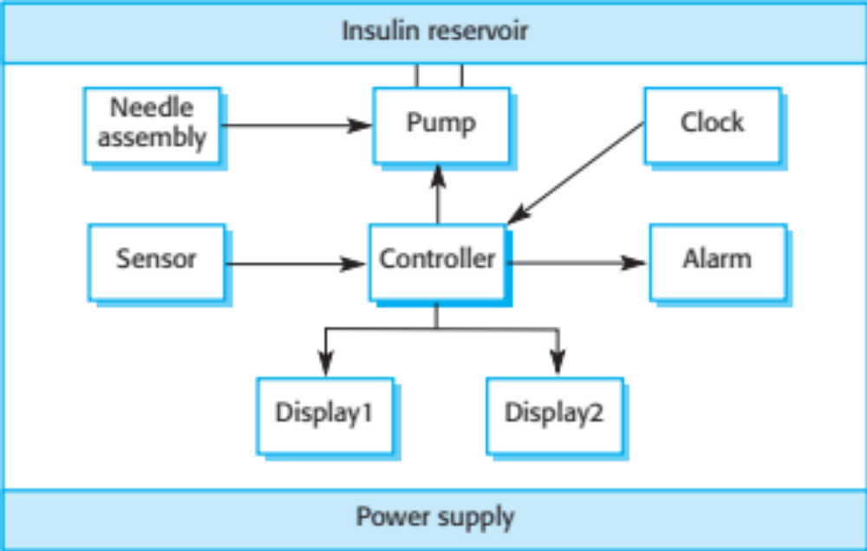
Insulin pump hardware architecture

Slide 36
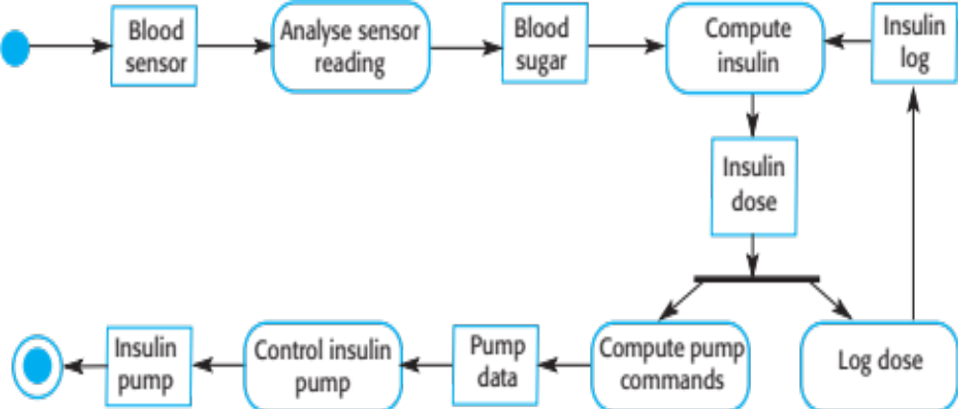
Activity model of the insulin pump

Slide 37
Essential high-level requirements
The system shall be available to deliver insulin when required.
The system shall perform reliably and deliver the correct amount of insulin to counteract the current level of blood sugar.
The system must therefore be designed and implemented to ensure that the system always meets these requirements.

Slide 38
Mentcare

Slide 39
Mentcare: A patient information system for mental health care
A patient information system to support mental health care is a medical information system that maintains information about patients suffering from mental health problems and the treatments that they have received.
Most mental health patients do not require dedicated hospital treatment but need to attend specialist clinics regularly where they can meet a doctor who has detailed knowledge of their problems.
To make it easier for patients to attend, these clinics are not just run in hospitals. They may also be held in local medical practices or community centres.

Slide 40
Mentcare
Mentcare is an information system that is intended for use in clinics.
It makes use of a centralized database of patient information but has also been designed to run on a PC, so that it may be accessed and used from sites that do not have secure network connectivity.
When the local systems have secure network access, they use patient information in the database but they can download and use local copies of patient records when they are disconnected.

Slide 41
Mentcare goals
To generate management information that allows health service managers to assess performance against local and government targets.
To provide medical staff with timely information to support the treatment of patients.

Slide 42
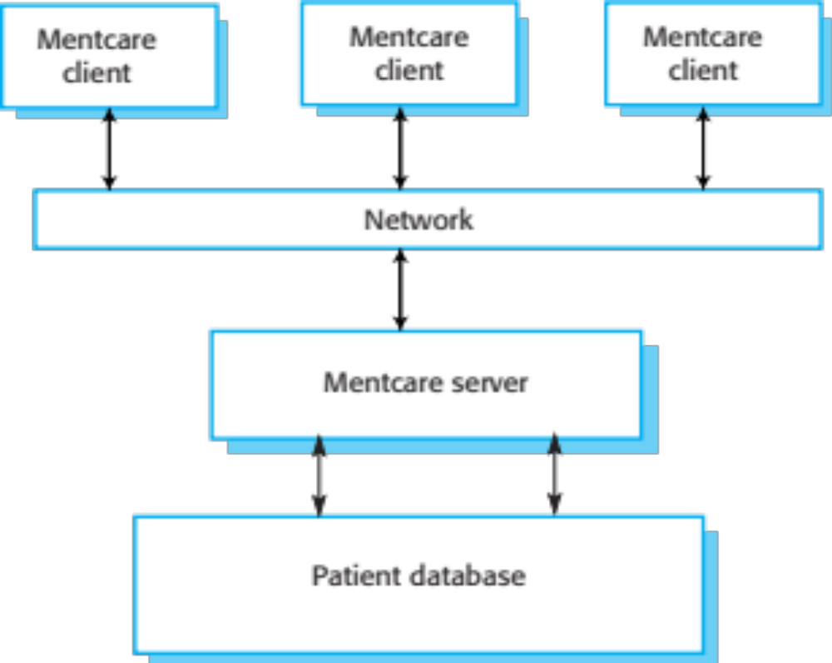
The organization of the Mentcare system

Slide 43
Key features of the Mentcare Systems
Individual care management
  Clinicians can create records for patients, edit the information in the system, view patient history, etc. The system supports data summaries so that doctors can quickly learn about the key problems and treatments that have been prescribed.
Patient monitoring
  The system monitors the records of patients that are involved in treatment and issues warnings if possible problems are detected.
Administrative reporting
  The system generates monthly management reports showing the number of patients treated at each clinic, the number of patients who have entered and left the care system, number of patients sectioned, the drugs prescribed and their costs, etc.

Slide 44
Mentcare System Concerns
Privacy
  It is essential that patient information is confidential and is never disclosed to anyone apart from authorised medical staff and the patient themselves.
Safety
  Some mental illnesses cause patients to become suicidal or a danger to other people. Wherever possible, the system should warn medical staff about potentially suicidal or dangerous patients.
  The system must be available when needed otherwise safety may be compromised and it may be impossible to prescribe the correct medication to patients.

Slide 45
Wilderness Weather Station

Slide 46
Wilderness Weather Station
The government of a country with large areas of wilderness decides to deploy several hundred weather stations in remote areas.
Weather stations collect data from a set of instruments that measure temperature and pressure, sunshine, rainfall, wind speed and wind direction.
  The weather station includes a number of instruments that measure weather parameters such as the wind speed and direction, the ground and air temperatures, the barometric pressure and the rainfall over a 24-hour period. Each of these instruments is controlled by a software system that takes parameter readings periodically and manages the data collected from the instruments.

Slide 47
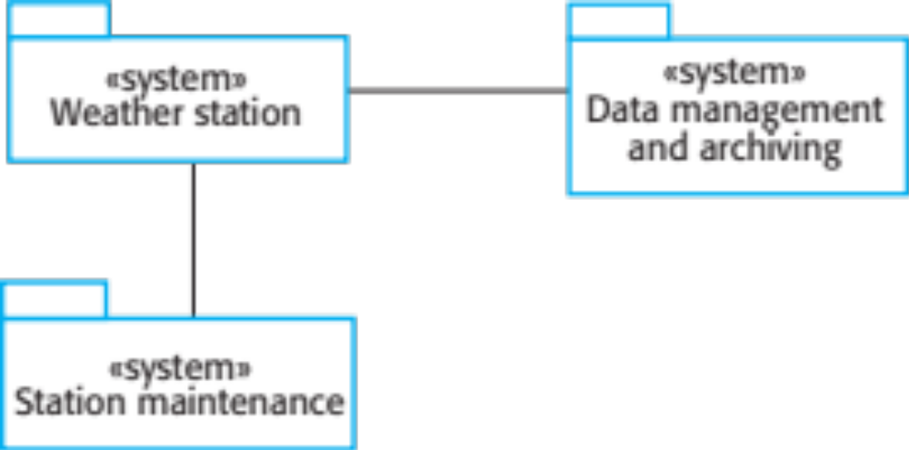
The Weather Station’s Environment

Slide 48
The Weather Information System
The weather station system
  This is responsible for collecting weather data, carrying out some initial data processing and transmitting it to the data management system.
The data management and archiving system
  This system collects the data from all of the wilderness weather stations, carries out data processing and analysis and archives the data.
The station maintenance system
  This system can communicate by satellite with all wilderness weather stations to monitor the health of these systems and provide reports of problems.

Slide 49
Additional Software Functionality
Monitor the instruments, power and communication hardware and report faults to the management system.
Manage the system power, ensuring that batteries are charged whenever the environmental conditions permit but also that generators are shut down in potentially damaging weather conditions, such as high wind.
Support dynamic reconfiguration where parts of the software are replaced with new versions and where backup instruments are switched into the system in the event of system failure.

Slide 50
iLearn: a digital Learning Environment

Slide 51
iLearn: a digital Learning Environment
A digital learning environment is a framework in which a set of general-purpose and specially designed tools for learning may be embedded plus a set of applications that are geared to the needs of the learners using the system.
The tools included in each version of the environment are chosen by teachers and learners to suit their specific needs.
  These can be general applications such as spreadsheets, learning management applications such as a Virtual Learning Environment (VLE) to manage homework submission and assessment, games and simulations.

Slide 52
Service Oriented Systems
The system is a service-oriented system with all system components considered to be a replaceable service.
This allows the system to be updated incrementally as new services become available.
It also makes it possible to rapidly configure the system to create versions of the environment for different groups such as very young children who cannot read, senior students, etc.

Slide 53
iLearn services
Utility services that provide basic application-independent functionality and which may be used by other services in the system.
Application services that provide specific applications such as email, conferencing, photo sharing etc. and access to specific educational content such as scientific films or historical resources.
Configuration services that are used to adapt the environment with a specific set of application services and do define how services are shared between students, teachers and their parents.

Slide 54
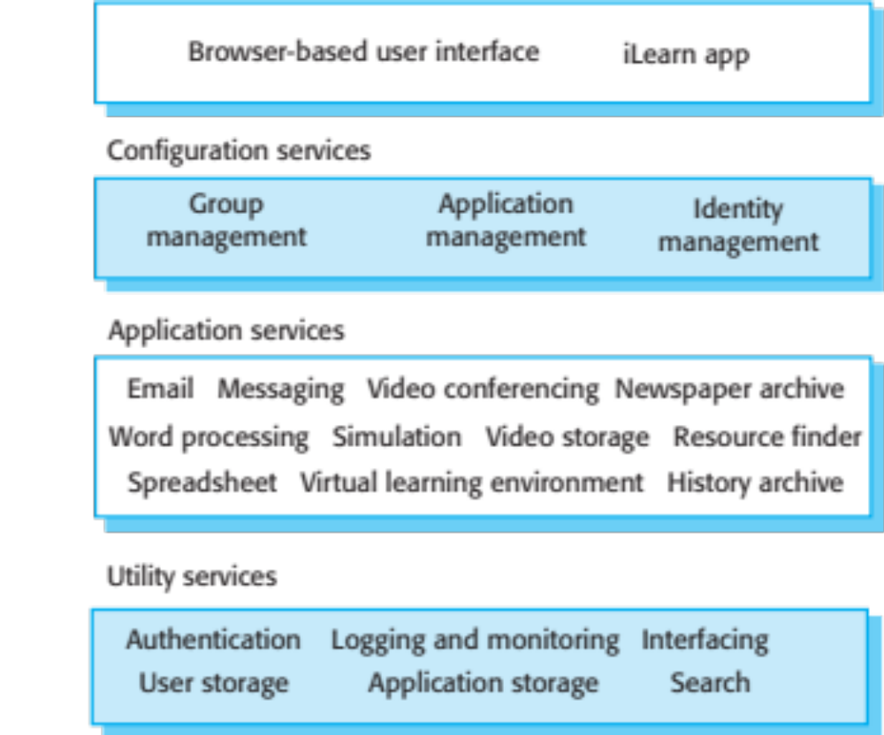
iLearn architecture

Slide 55
iLearn Service Integration
Integrated services are services which offer an API (application programming interface) and which can be accessed by other services through that API. Direct service-to-service communication is therefore possible.
Independent services are services which are simply accessed through a browser interface and which operate independently of other services. Information can only be shared with other services through explicit user actions such as copy and paste; re-authentication may be required for each independent service.

Slide 56
Key Points
Software engineering is an engineering discipline that is concerned with all aspects of software production.
Essential software product attributes are maintainability, dependability and security, efficiency and acceptability.
The high-level activities of specification, development, validation and evolution are part of all software processes.
The fundamental notions of software engineering are universally applicable to all types of system development.

Slide 57
Process Activities
Real software processes are inter-leaved sequences of technical, collaborative and managerial activities with the overall goal of specifying, designing, implementing and testing a software system.
The four basic process activities of specification, development, validation and evolution are organized differently in different development processes.
For example, in the waterfall model, they are organized in sequence, whereas in incremental development they are interleaved.

Slide 58
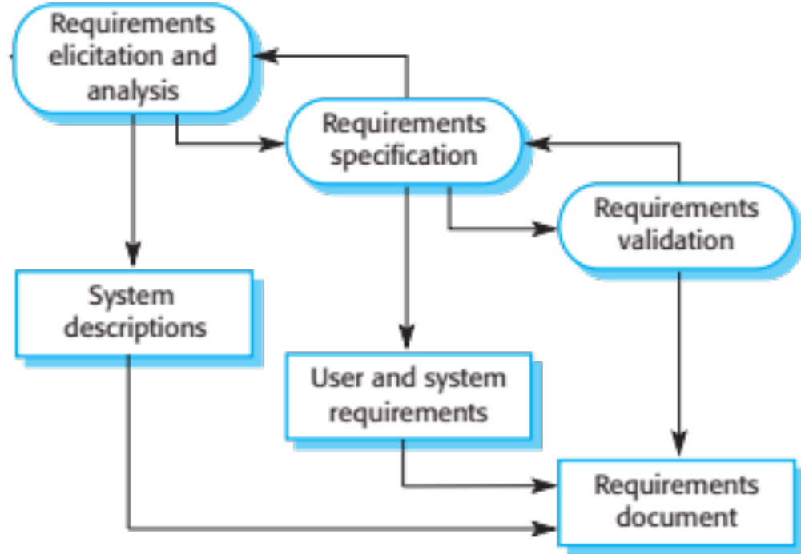
The requirements Engineering Process

Slide 59
Software Specification
The process of establishing what services are required and the constraints on the system’s operation and development.
Requirements engineering process
  Requirements elicitation and analysis
    What do the system stakeholders require or expect from the system?
  Requirements specification
    Defining the requirements in detail
  Requirements validation
    Checking the validity of the requirements

Slide 60
Software Design and Implementation
The process of converting the system specification into an executable system.
Software design
  Design a software structure that realises the specification;
Implementation
  Translate this structure into an executable program;
The activities of design and implementation are closely related and may be inter-leaved.

Slide 61
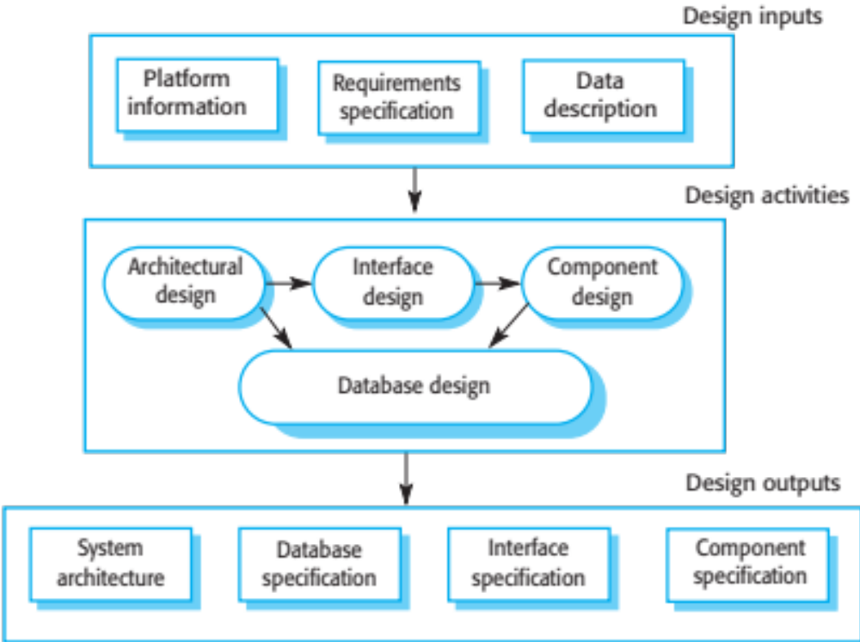
A general Model of the Design Process

Slide 62
Software Validation
Verification and validation (V & V) is intended to show that a system conforms to its specification and meets the requirements of the system customer.
Involves checking and review processes and system testing.
System testing involves executing the system with test cases that are derived from the specification of the real data to be processed by the system.
Testing is the most commonly used V & V activity.

Slide 63
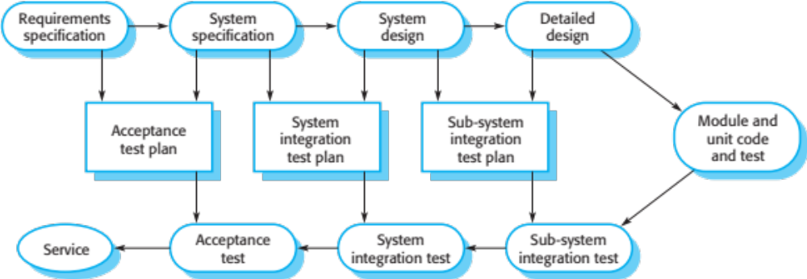
Testing phases in a plan-driven software process

Slide 64
Coping with change

Slide 65
Coping with change
Change is inevitable in all large software projects.
  Business changes lead to new and changed system requirements
  New technologies open up new possibilities for improving implementations
  Changing platforms require application changes
Change leads to rework so the costs of change include both rework (e.g. re-analysing requirements) as well as the costs of implementing new functionality

Slide 66
Reducing the costs of rework
Change anticipation, where the software process includes activities that can anticipate possible changes before significant rework is required.
  For example, a prototype system may be developed to show some key features of the system to customers.
Change tolerance, where the process is designed so that changes can be accommodated at relatively low cost.
  This normally involves some form of incremental development. Proposed changes may be implemented in increments that have not yet been developed. If this is impossible, then only a single increment (a small part of the system) may have be altered to incorporate the change.

Slide 67
Coping with changing requirements
System prototyping, where a version of the system or part of the system is developed quickly to check the customer’s requirements and the feasibility of design decisions. This approach supports change anticipation.
Incremental delivery, where system increments are delivered to the customer for comment and experimentation. This supports both change avoidance and change tolerance.

Slide 68
Software prototyping
A prototype is an initial version of a system used to demonstrate concepts and try out design options.
A prototype can be used in:
  The requirements engineering process to help with requirements elicitation and validation;
  In design processes to explore options and develop a UI design;
  In the testing process to run back-to-back tests.

Slide 69
Benefits of prototyping
Improved system usability.
A closer match to users’ real needs.
Improved design quality.
Improved maintainability.
Reduced development effort.

Slide 70
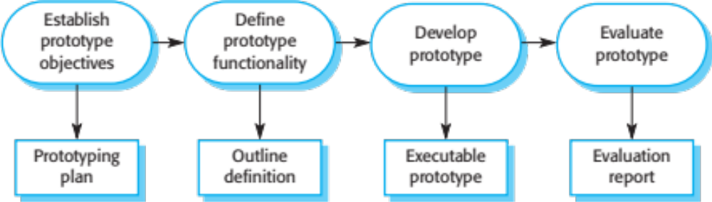
The process of prototype development

Slide 71
Prototype development
May be based on rapid prototyping languages or tools
May involve leaving out functionality
  Prototype should focus on areas of the product that are not well-understood;
  Error checking and recovery may not be included in the prototype;
  Focus on functional rather than non-functional requirements such as reliability and security

Slide 72
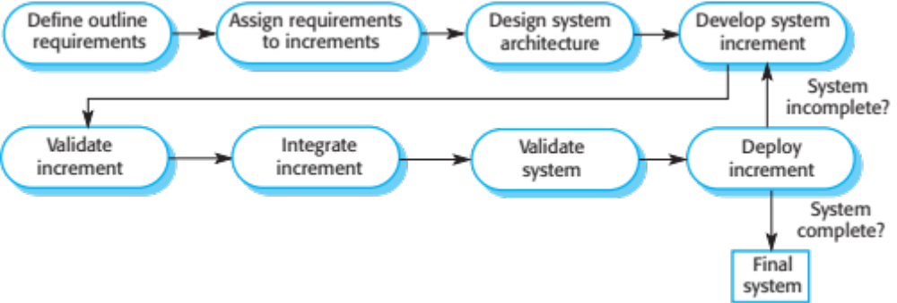
Incremental delivery

Slide 73
Incremental delivery advantages
Customer value can be delivered with each increment so system functionality is available earlier.
Early increments act as a prototype to help elicit requirements for later increments.
Lower risk of overall project failure.
The highest priority system services tend to receive the most testing.

Slide 74
Process metrics
Time taken for process activities to be
completed
  E.g. Calendar time or effort to complete an activity or process.
Resources required for processes or activities
  E.g. Total effort in person-days.
Number of occurrences of a particular event
  E.g. Number of defects discovered.

Slide 75
Key points
Software processes are the activities involved in producing a software system. Software process models are abstract representations of these processes.
General process models describe the organization of software processes.
  Examples of these general models include the ‘waterfall’ model, incremental development, and reuse-oriented development.
Requirements engineering is the process of developing a software specification.

Slide 76
Key points
Design and implementation processes are concerned with transforming a requirements specification into an executable software system.
Software validation is the process of checking that the system conforms to its specification and that it meets the real needs of the users of the system.
Software evolution takes place when you change existing software systems to meet new requirements. The software must evolve to remain useful.
Processes should include activities such as prototyping and incremental delivery to cope with change.

